Slide 1
Early and accurate identification of patients who are at risk of developing sepsis using Artificial Intelligence and computational methods

Slide 2
SEPSIS
Life-threatening organ dysfunction caused by a dysregulated host response to infection.
Covid-19; cytokine storm
10 % mortality
Septic shock
subset of sepsis
Patient exhibit particularly profound circulatory, cellular, and metabolic abnormalities and are associated with a greater risk of mortality(40 %)

Slide 3
Sepsis - Epidemiology
A major public health concern
Accounts for more than $20 billion (5.2%) of total US hospital costs in 2011
The reported incidence of sepsis is increasing likely reflecting aging populations with more comorbidities, greater recognition (less reported before)
Sepsis is a leading cause of mortality and critical illness worldwide.
Patients who survive sepsis often have long-term physical, psychological, and cognitive disabilities with significant health care and social implications
Final showdown in life
Ageing Process
No escape

Slide 4
Early prediction of sepsis is crucial in preventing mortality
Sepsis management is highly time sensitive.
Early fluid resuscitation is recommended to commence within the first 3 h to stabilize sepsis-induced tissue hypoperfusion.
Administration of intravenous antimicrobials is recommended to commence at the earliest possible time, specifically within 1 h of sepsis.
Sepsis mortality increases significantly with each hour of delay in antimicrobials administration.

Slide 5
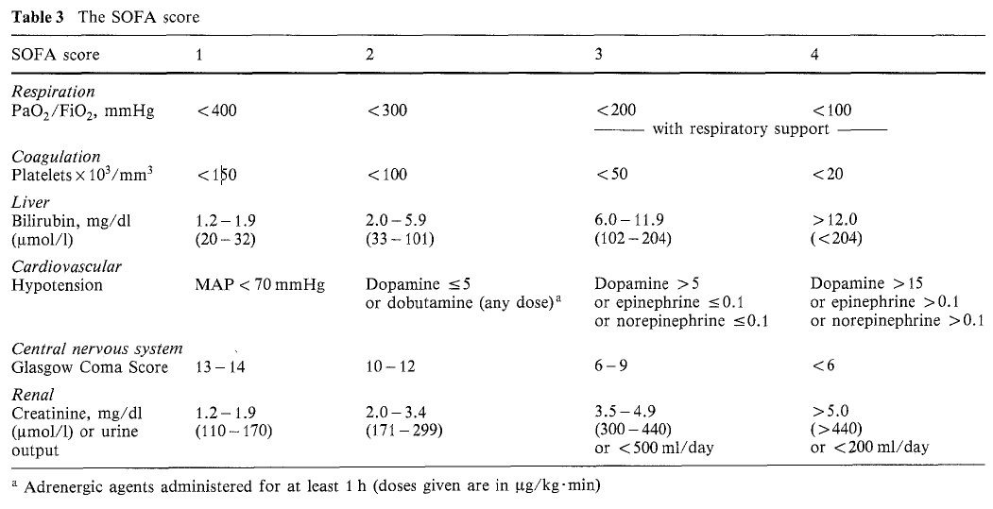
SOFA score (Sequential [Sepsis-related] Organ Failure Assessment; Organ dysfunction represented as increase in 2 or more points)

Slide 6
SEPSIS
Early and accurate identification of patients who are at risk of developing sepsis
How to optimize treatment based on differences in severity of damage in different organs using data science and machine learning
Hospitals moving towards better Data recordings and Management leading to BigData availability, aiding in building better models of prediction
Moving from Scoring systems and Statistical Models

Slide 9
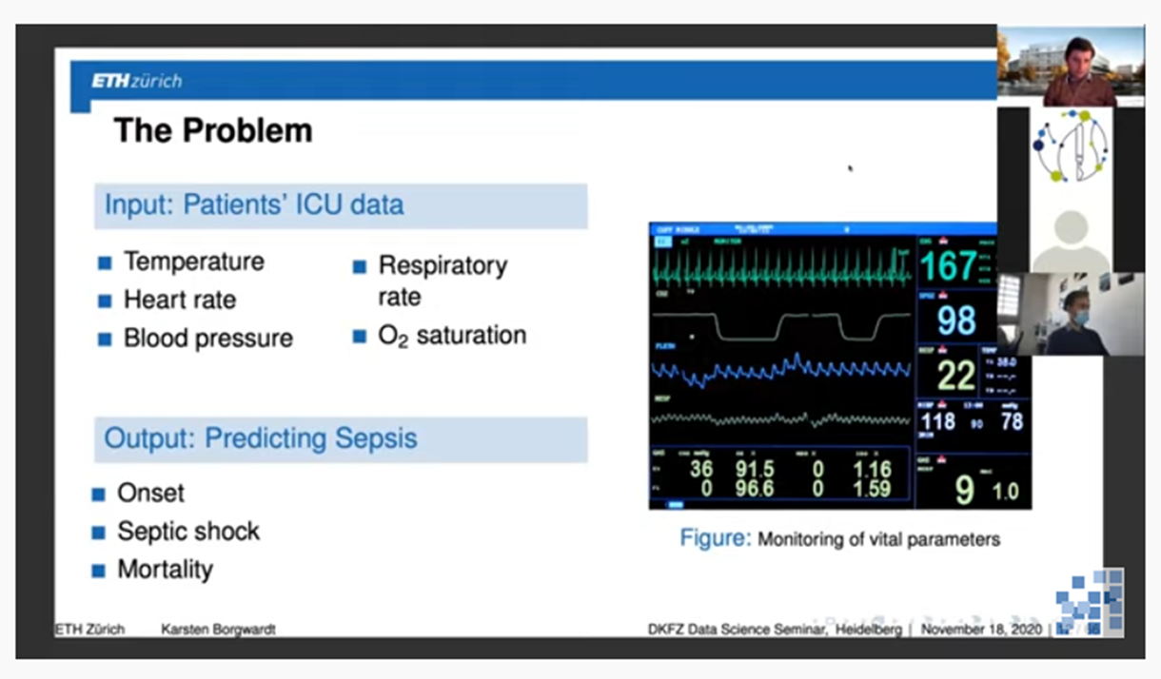
Big Data Problem
MultiOrgan dysfunction
Demographics data
Age, Gender, Ethnicity, SES, Geographical location
Ageing Parameters
Comorbidities
Diabetes, Blood pressure, Mental health, CKD, COPD
Vital Signs
Temperature, Heart rate, Blood pressure, Respiratory rate, SpO2, GCS
Biochemical Parameters
Glucose, Lactate, pH
CBP, LFT, KFT, TFT,

Slide 10
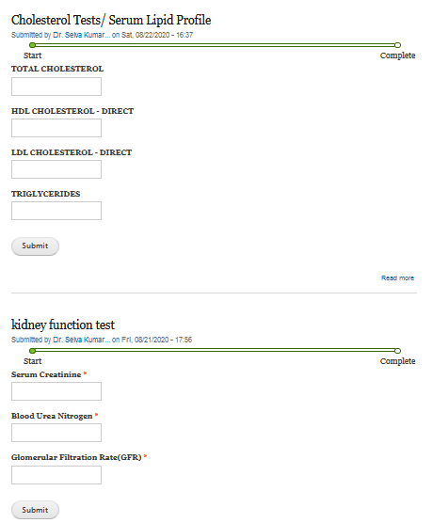
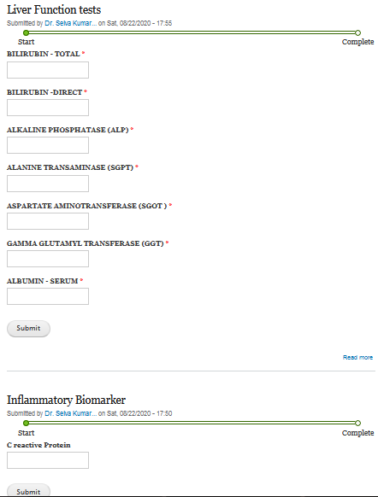
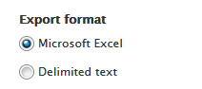

Slide 11
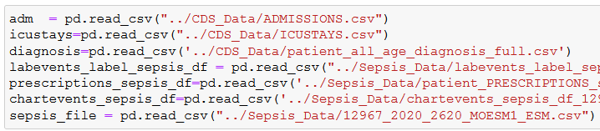
Mimic DataSet (Beth Israel Hospital/MIT) – 60000 patients

Slide 12
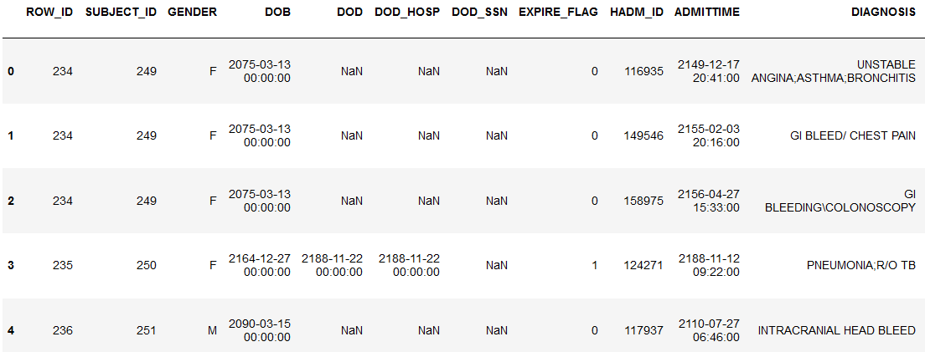
De-identified data - 60000 patients - MIMIC

Slide 13
Data Science
Data Engineering

Slide 14
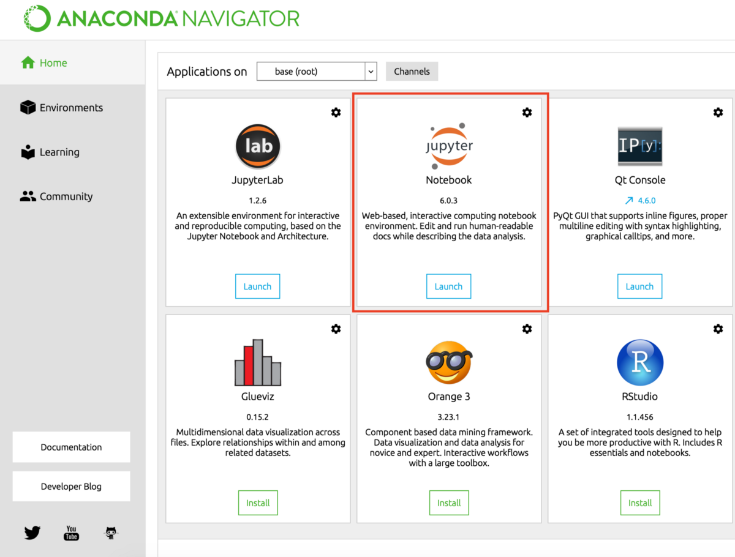
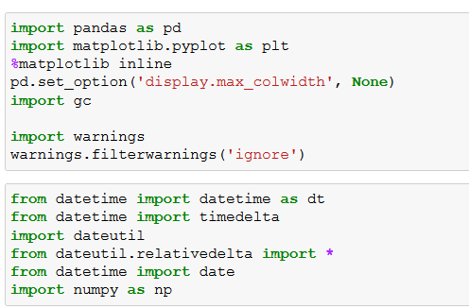

Python; Anaconda; Jupyter Notebook

Slide 15
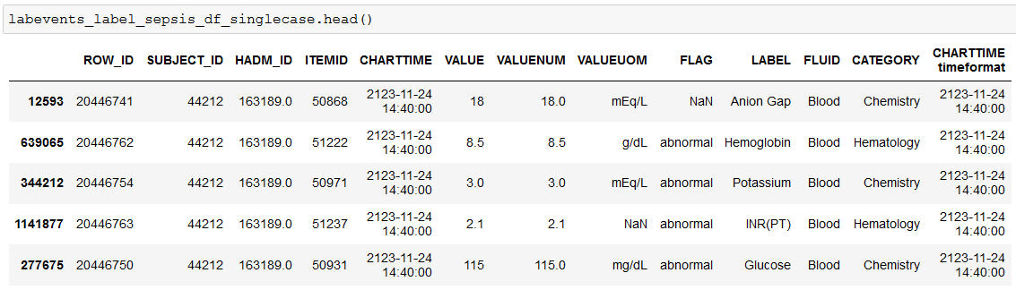

Slide 16
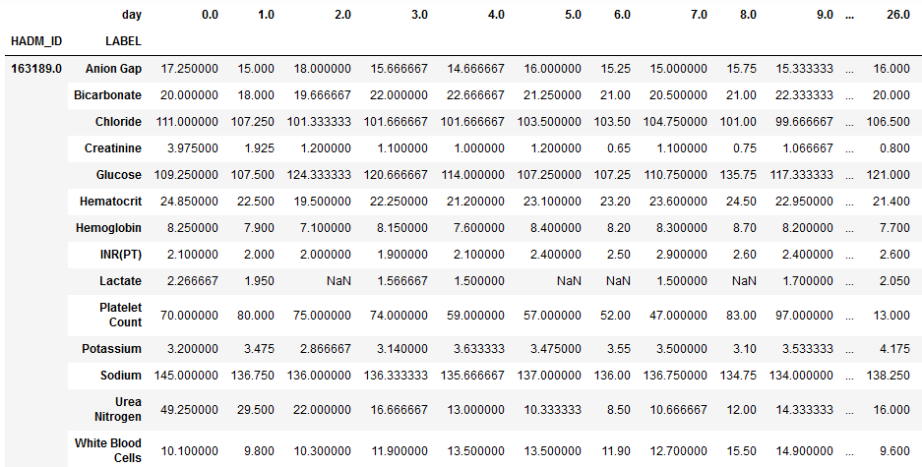

Slide 17
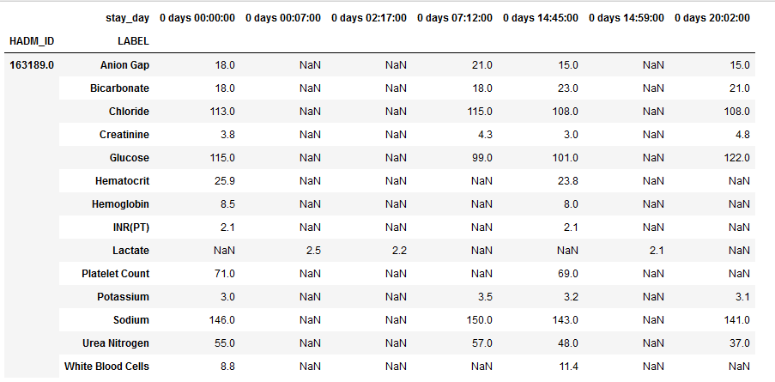

Slide 18
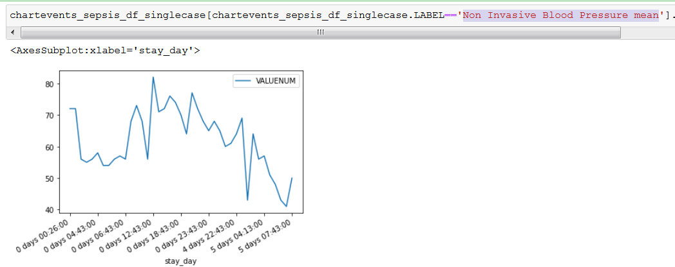
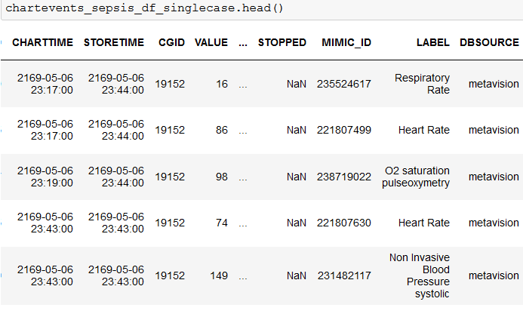

Slide 19
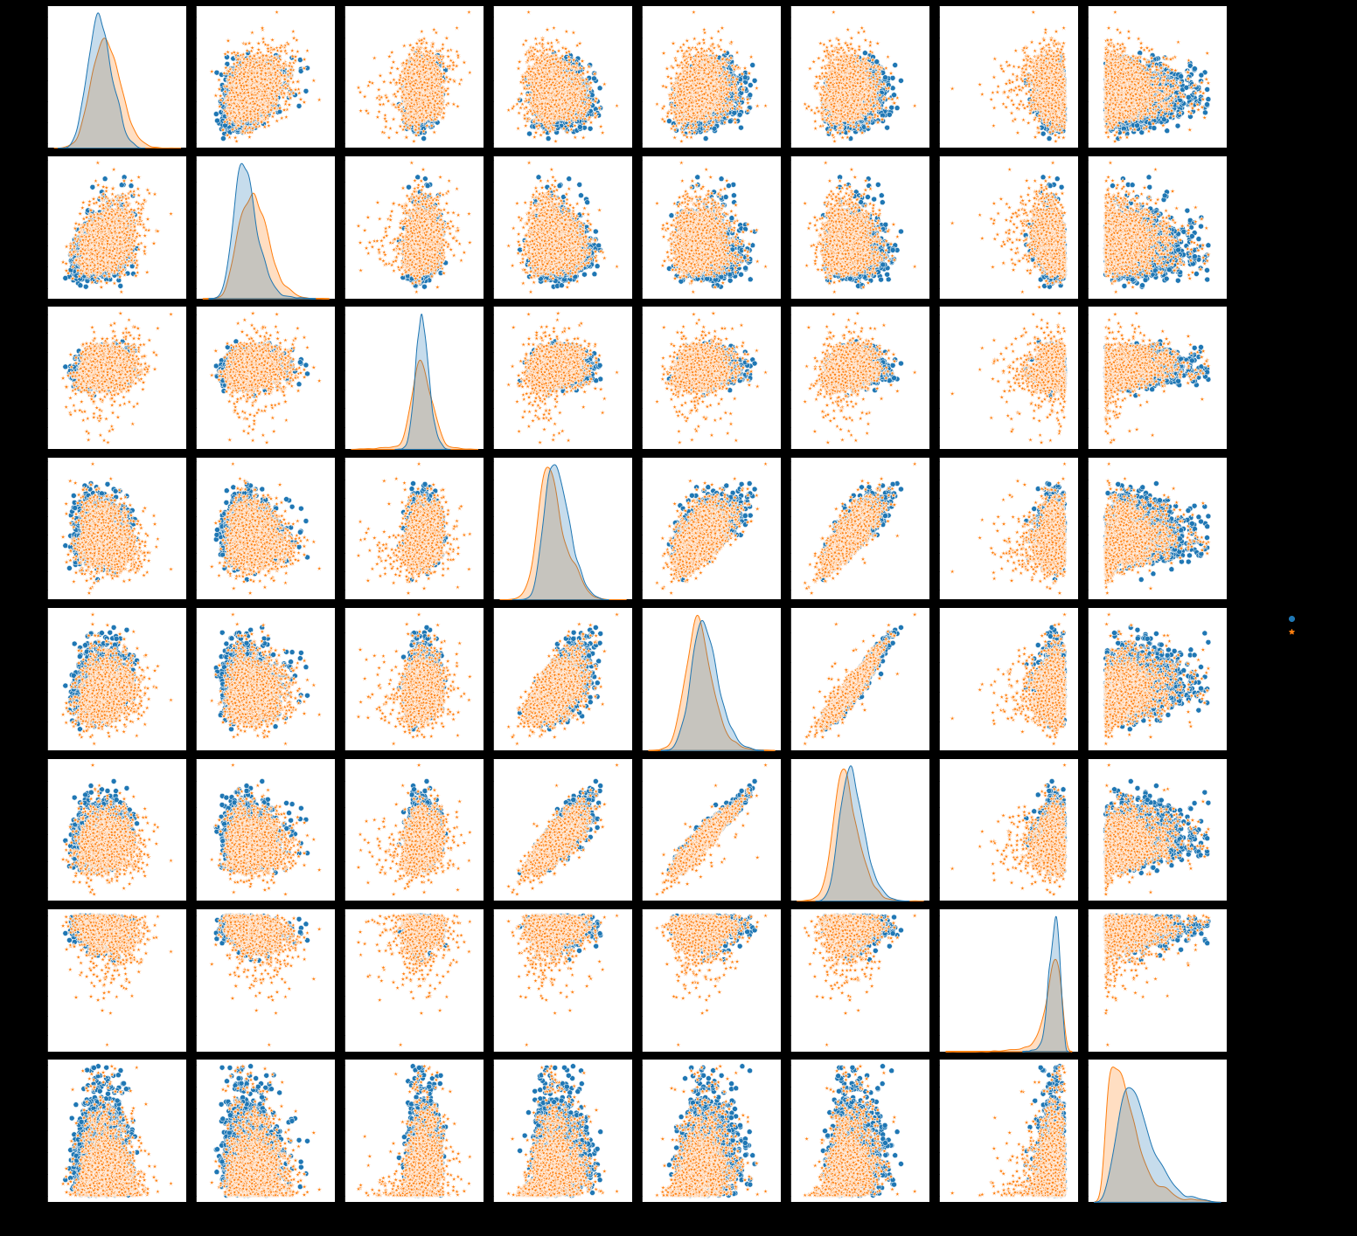

Slide 20
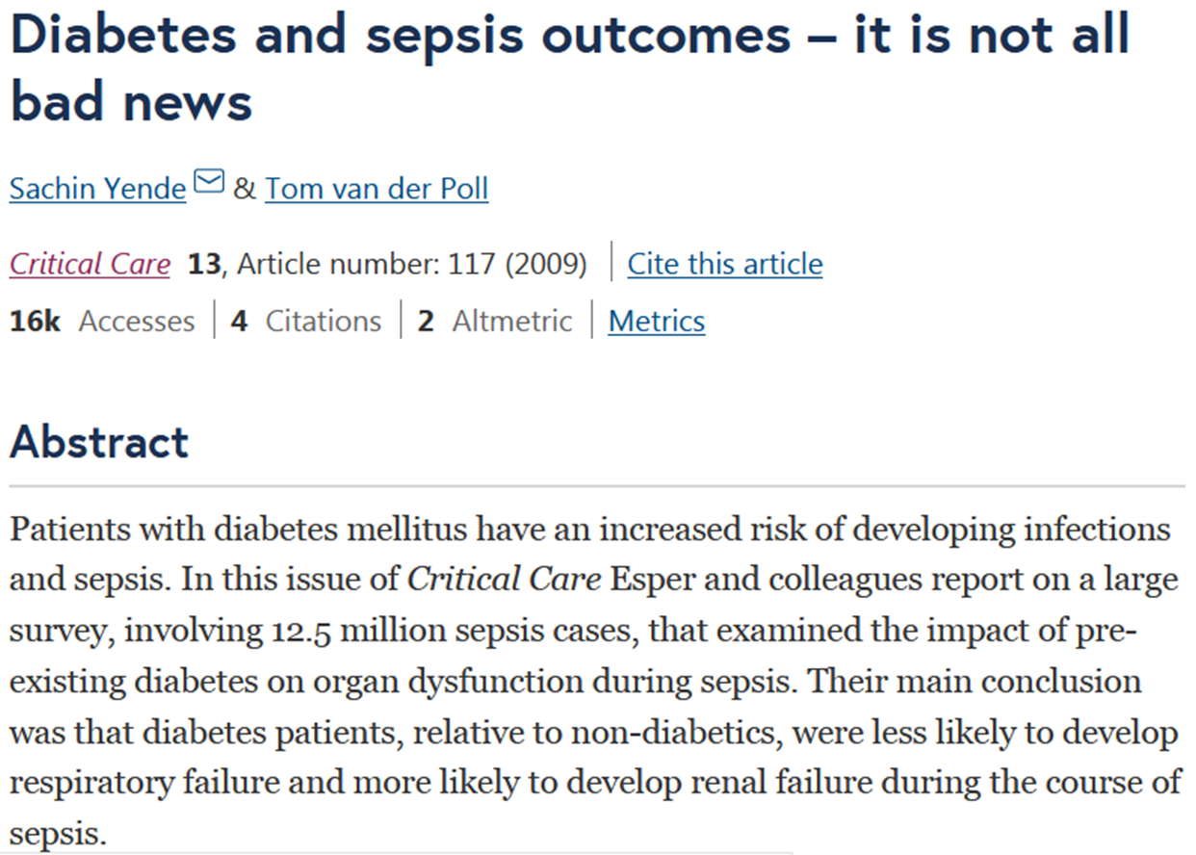
Diabetes
Sepsis
Steroid
Cytokines
Congestive heart failure
Acute renal failure

Slide 21
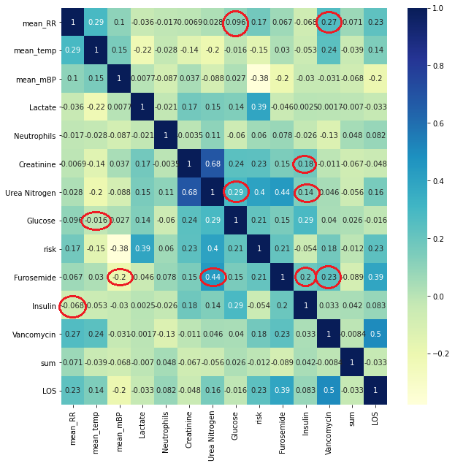

Slide 22
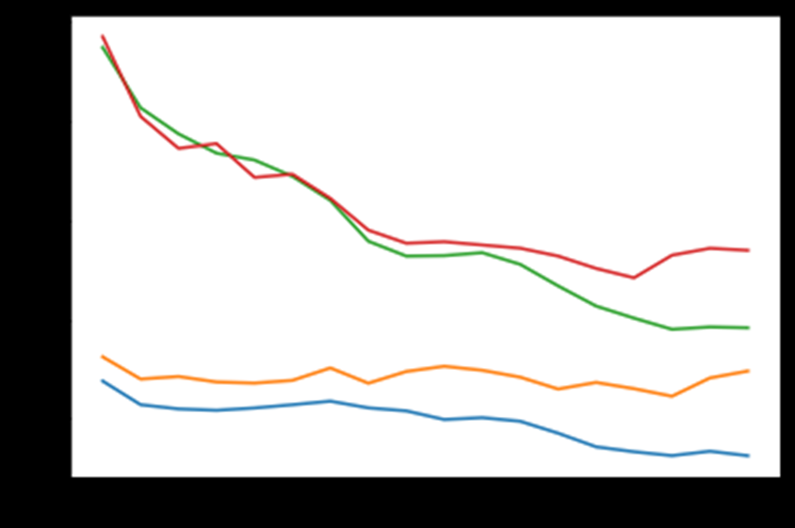
Predicting from dynamics (Time Series Data)
Even though starts at high and one starts at low after three days we can predict which high value person will be alive and which low value person will expire
Building models to utilize the dynamics in time series for better prediction.

Slide 23
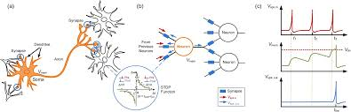
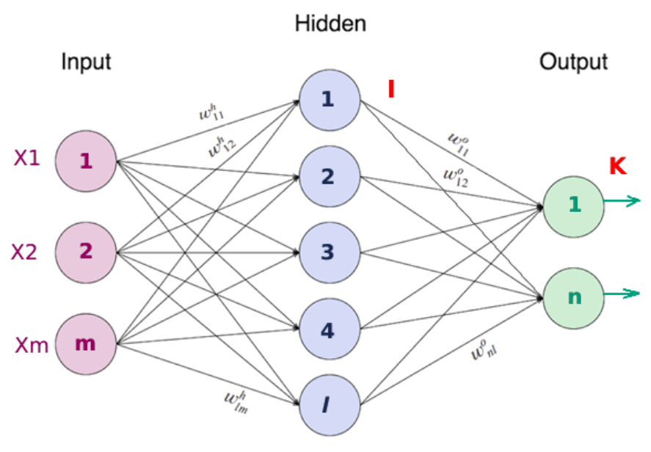
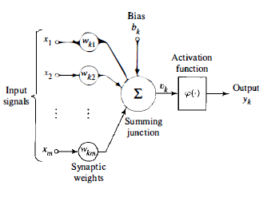
Artificial Intelligence – Neural Network – Deep learning

Slide 24
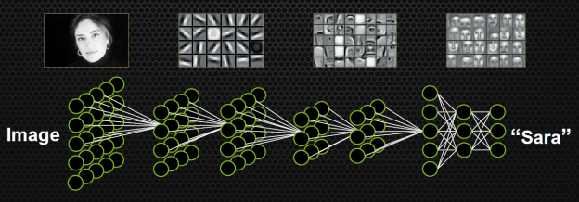
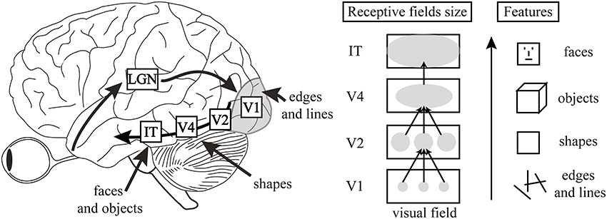

Slide 25
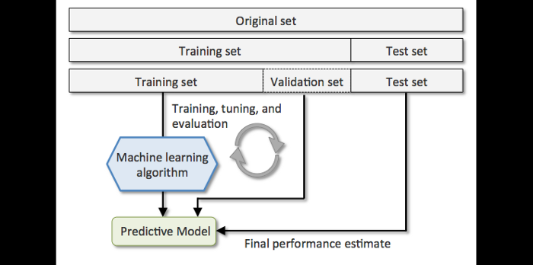
End to end learning

Slide 26
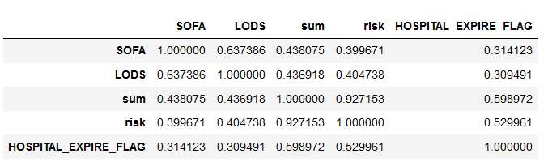
Correlation Table

Slide 27
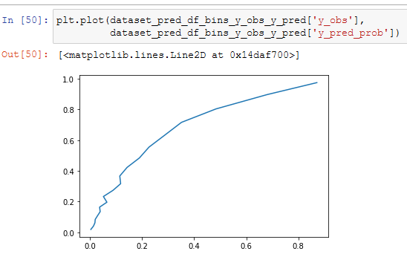
AI based triaging
Quantitative details
A number/value

Slide 28
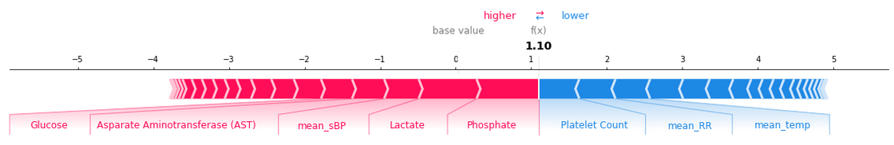
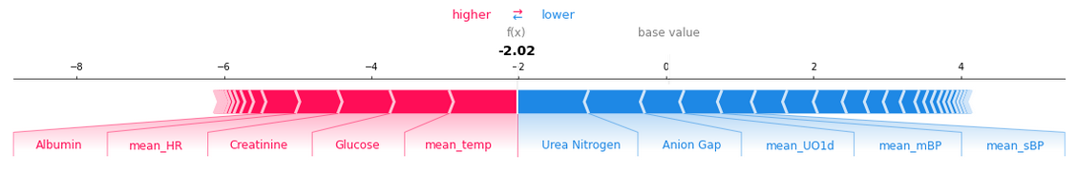
Shapley Values - AI

Slide 29
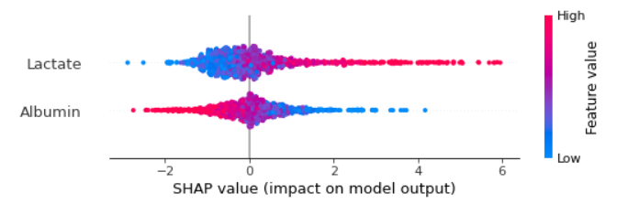
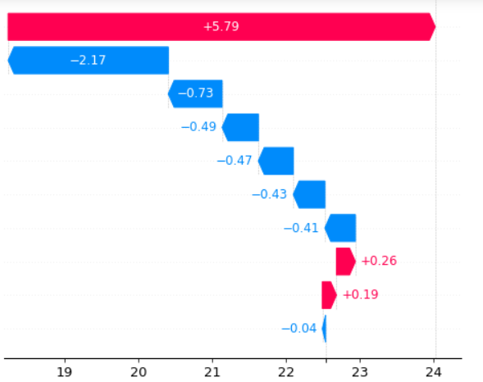
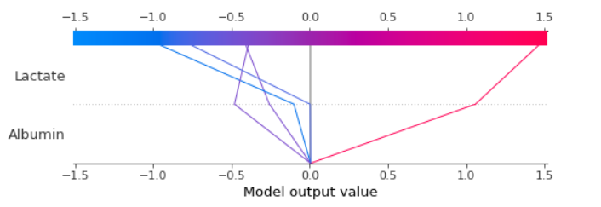

Slide 30
data preparation; preprocessing
Normalization
Datascience and Data Engineering
Feature selection
training; testing validation;
overfitting and underfitting
Supervised, unsupervised learning and reinforcement learning;
Sequential, cnn, and recurrent neural networks
LSTM
Transfer learning;

Slide 31
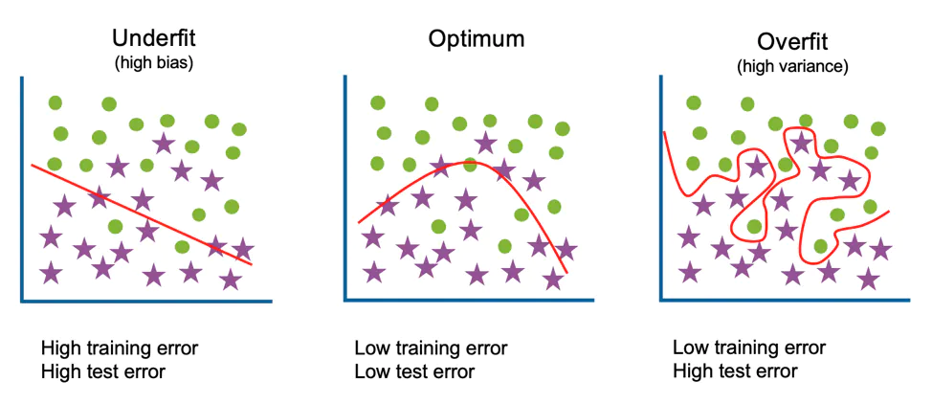

Slide 32
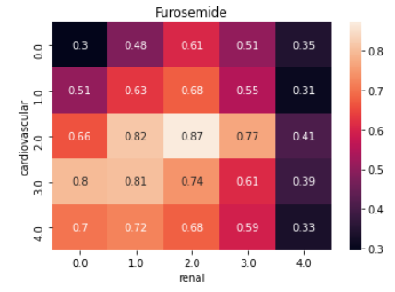
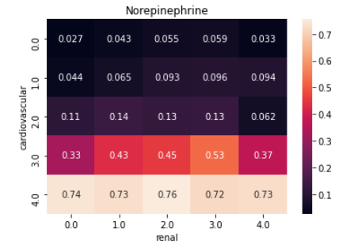
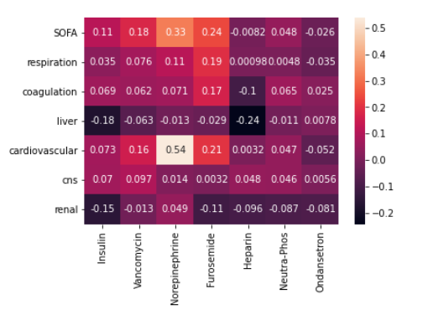
Dynamic prediction of dosage based on changes in organ damage

Slide 33
Training for treatment prediction in ICU
Optimizing the ying and yang in Multiorgan disorder | SOFA Score | Diagnosis | Lab values as input
Kidney Damage | 0-5 | Pre renal post renal | eGFR, creatinine, BUN;
Heart Damage |  | RVDF, LVDF, sDF, vDf | Stroke volume; Ejection fraction; Heart rate
Infections |  | Gram positive, gram negative | WBC; Culture; Temperature
Respiration |  |  | Spo2; Respiratory rate
Diabetics
Medicine as output target | CHF; SEPSIS
Fluids, diuretics | Quantitative Adjustment
Ionotropics Chronotropics
Antibiotics
Oxygen
Insulin

Slide 34
Combining markers for individual organs and markers as a whole
Improving prediction based on science and tools and techniques
How to maximize detection
Tracking mode of disease severity trend and reduction of severity by targeted effective treatment
Differential predictors of death (cause of death)
Renal failure
Severity score
Heart failure
Severity score
Respiratory failure etc
Severity score
Sepsis
Severity score
Which organ is critical and how to manage
Both organ prediction and mortality prediction
How the patients is going to die

Slide 35
Why its predicting chance of death is high
Explainable AI
Patient expired or alive (Earlier models)
Why its predicting expiry or alive
Compare with doctor’s /expertise
Capturing Very subtle differences
Sometime hard for humans to evaluate especially under time and resource constraints (Human capital)
Discussion with medical colleagues

Slide 36
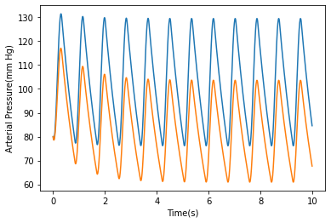
Mathematical Model of sepsis
Mathematical modeling of septic shock based on clinical data

Slide 37
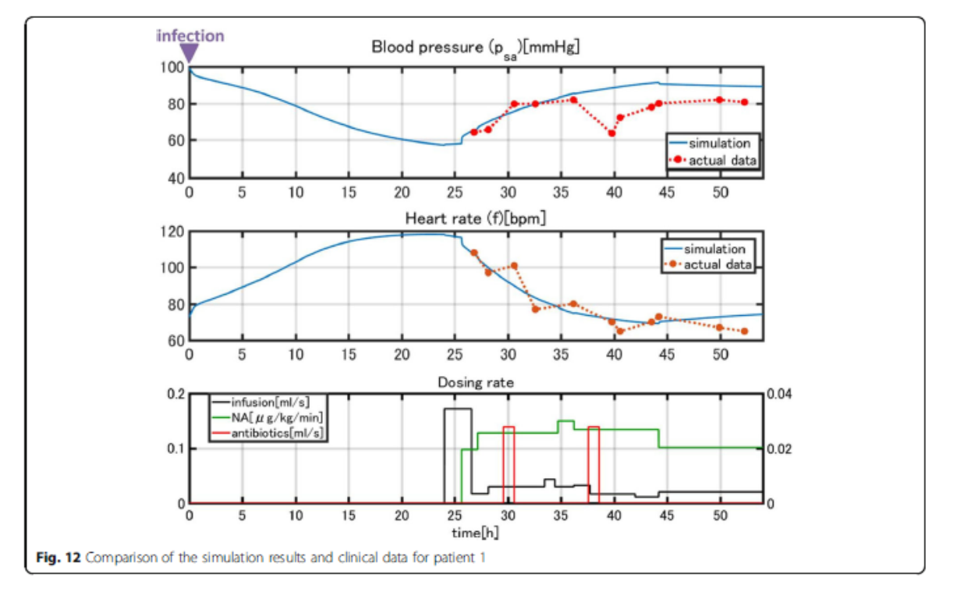
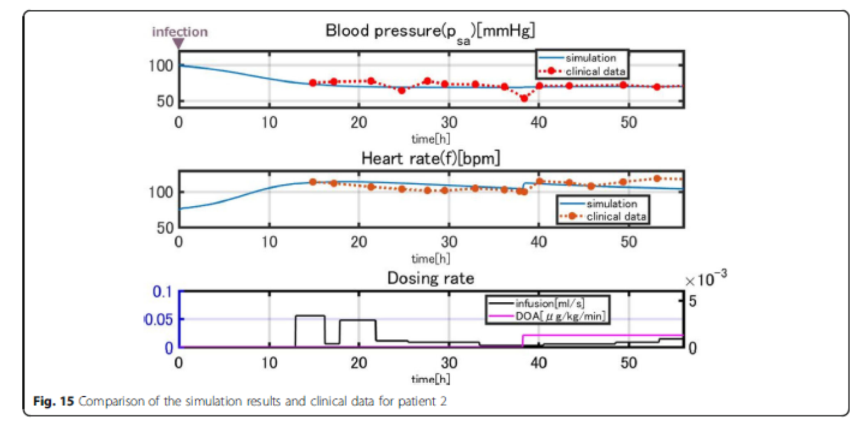
Mathematical modeling of septic shock based on clinical data - https://doi.org/10.1186/s12976-019-0101-9

